Slide 1

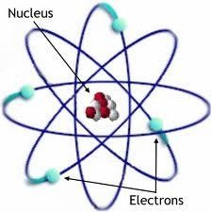
PROPERTIES OF MATTER

Slide 2
https://quizizz.com/admin/quiz/632c057aade69a001da5079c?source=quiz_share

Slide 3
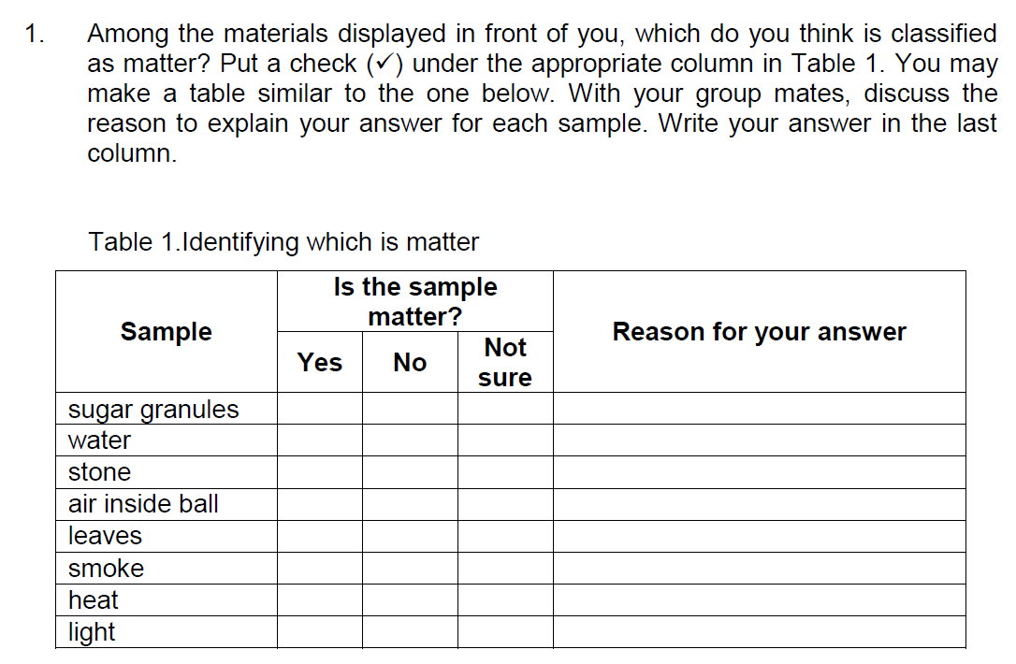

Slide 5
Characteristics that describe a sample of matter are called properties

Slide 6
Two main properties of matter
measure of the amount of matter the object has
MASS

Slide 7
Two main properties of matter
The measure of the space occupied by an object is called
VOLUME

Slide 8
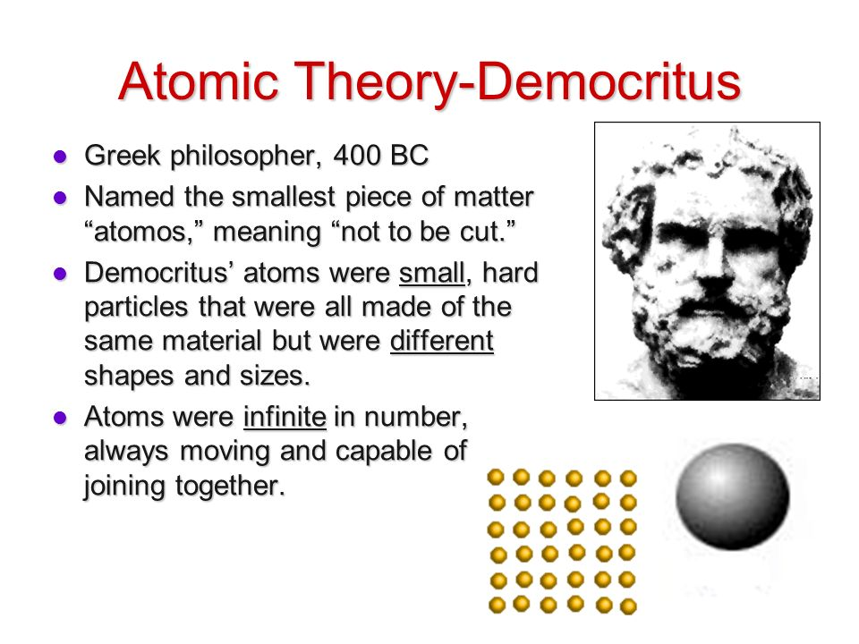

Slide 9
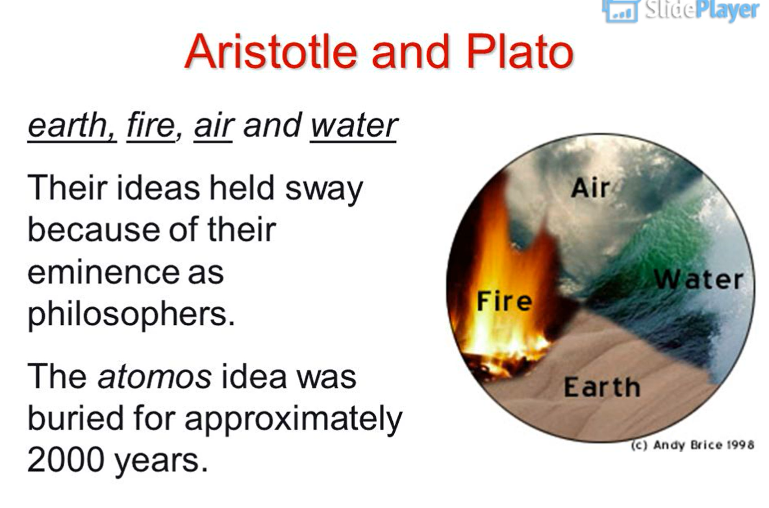

Slide 10
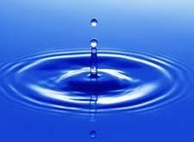

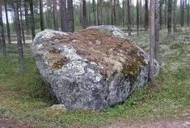
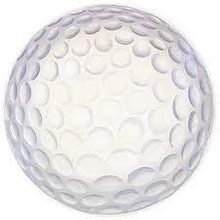
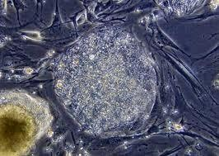

WHAT IS MATTER?
Matter is anything that has mass and takes up space (volume).
Examples of matter:

Slide 11


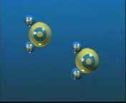

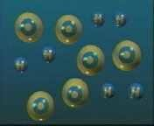
LAW OF CONSERVATION OF MATTER
MATTER CANNOT BE CREATED OR DESTROYED
IT JUST CHANGES FROM ONE FORM TO ANOTHER.
(MATTER GETS RECYCLED)

Slide 12












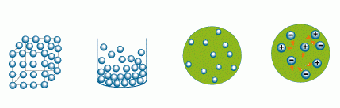
THEORY OF KINETIC ENERGY
ATOMS ARE ALWAYS MOVING
THE MORE ENERGY ADDED TO THE ATOMS, THE FASTER & FARTHER APART THEY MOVE
ENERGY ADDED
ENERGY ADDED

Slide 13
THEORY OF KINETIC ENERGY
ATOMS ARE ALWAYS MOVING
THE MORE ENERGY ADDED TO THE ATOMS, THE FASTER & FARTHER APART THEY MOVE
ENERGY ADDED
ENERGY ADDED

Slide 14
Kinetic Molecular Theory
explains the forces between molecules and the energy that they possess. This theory is based on three theories about matter.
ENERGY ADDED
ENERGY ADDED

Slide 15
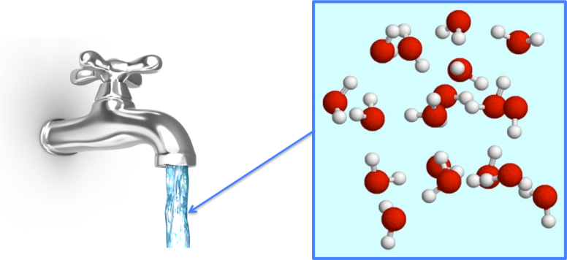
Kinetic Molecular Theory
1. Matter is composed of small particles (atoms, molecules, and ions).

Slide 16
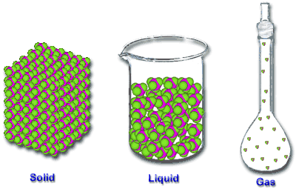
Kinetic Molecular Theory
2. The space the molecules occupy (volume) depends on the space between the molecules and not the space the molecules occupy themselves

Slide 17
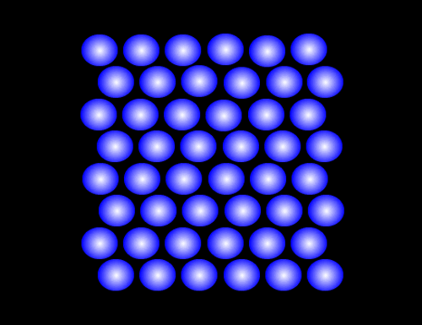
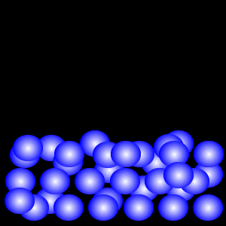

Kinetic Molecular Theory
3. The molecules are in constant motion. They are colliding with each other and the walls of their container without significant loss of energy.

Slide 18
MATTER
Matter can be described by using physical and chemical properties.
These are characteristics of matter that make it unique.
Physical Properties are properties that can be observed or measured.
color, mass, length, volume, density, state, etc.
Physical Properties can be either:
Observable or Measurable

Slide 19




OBSERVABLE PHYSICAL PROPERTIES
Properties in which you use your five senses to get information about an object.
If you can describe the matter based on what it looks, feels, smells or tastes like, you are describing the physical properties.

Slide 20
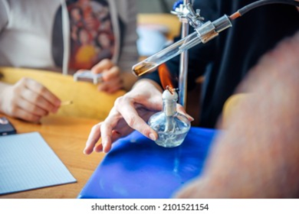
Chemical Properties- Properties that determine whether or not a substance will react chemically.
can only be measured by attempting to change the chemical identity of a material through a chemical reaction.

Slide 21
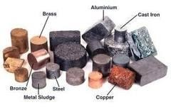
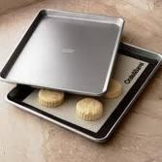
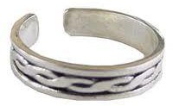

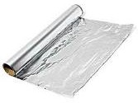
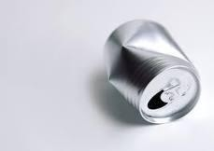

EXAMPLES OF OBSERVABLE PHYSICAL PROPERTIES
Malleability - the ability of a substance to be pounded into thin sheets.

Slide 22
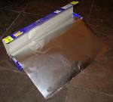
Physical Properties
Malleability: The ability to be pressed or pounded into a thin sheet
Tin foil
www.questiontechnology.org/blog/offtopic/

Slide 23
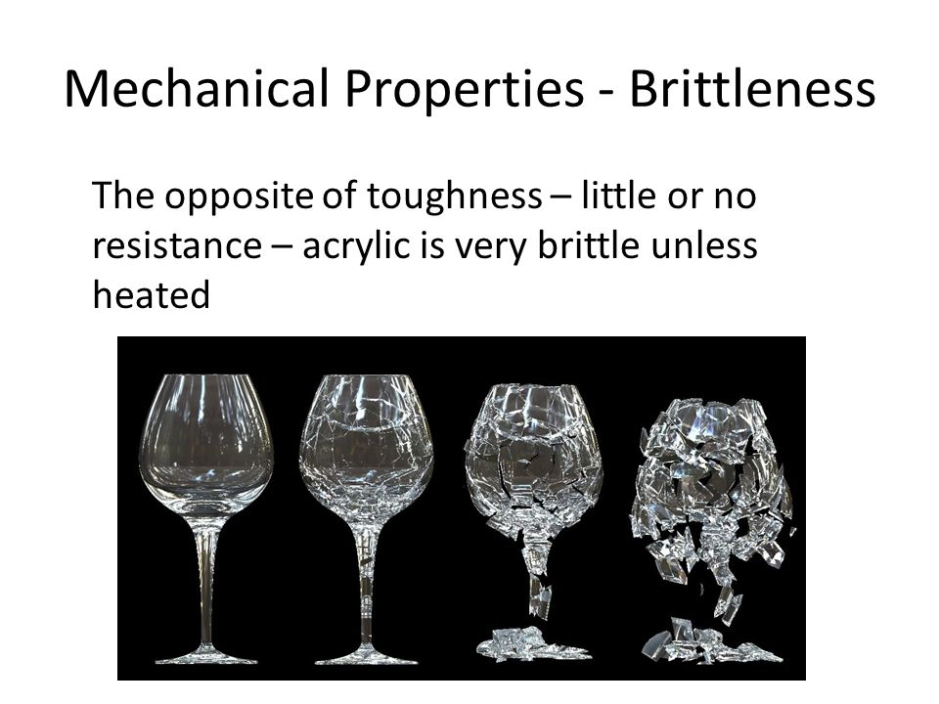

Slide 24
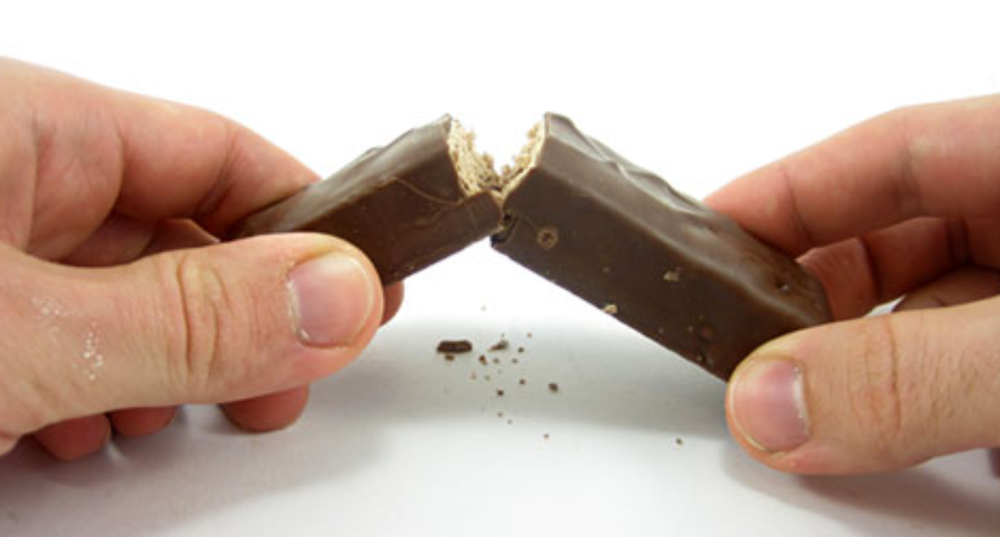

Slide 25
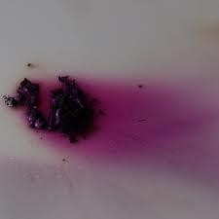
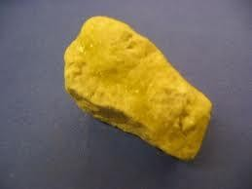
EXAMPLES OF OBSERVABLE PHYSICAL PROPERTIES
Color: The color of object can be seen and is a physical property of matter.
Color can help identify a substance. For example, sulfur is usually yellow in color, iodine is usually red in color.
Sulfur
Iodine

Slide 26
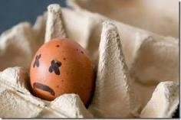

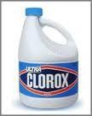
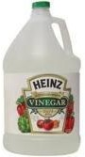
EXAMPLES OF OBSERVABLE PHYSICAL PROPERTIES
Odor: The smell or odor an object gives off can
also help identify a substance.
For example, sulfur has a rotten egg smell, vinegar has a very acidic smell, and chlorine has a very strong bleach smell.

Slide 27
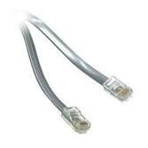
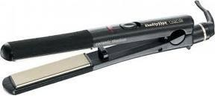
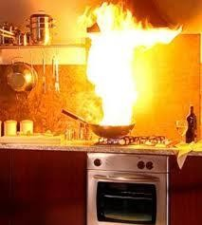

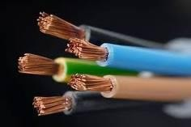
EXAMPLES OF OBSERVABLE PHYSICAL PROPERTIES
Conductor of heat or electricity: The ability for heat and electricity to pass through an object easily.
Metals are usually the best conductors of heat and electricity.

Slide 28
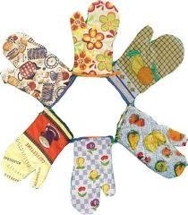
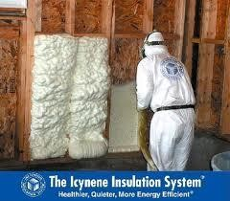
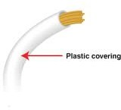
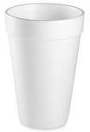
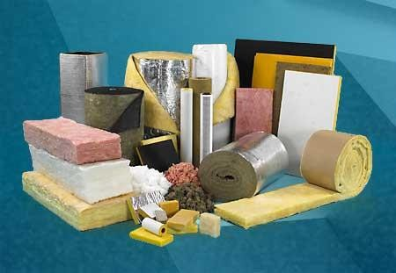

EXAMPLES OF OBSERVABLE PHYSICAL PROPERTIES
Insulator of heat or electricity: when an object passes heat and electricity poorly.
Nonmetals are usually good insulators.

Slide 29
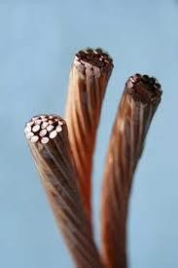

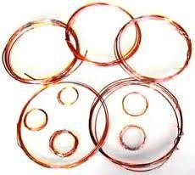
EXAMPLES OF OBSERVABLE PHYSICAL PROPERTIES
Ductility - the ability to be drawn or pulled into a
wire.
Metals are usually ductile.

Slide 30
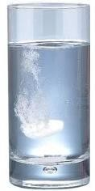
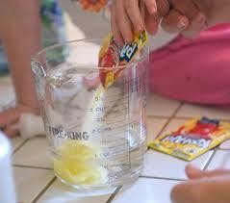
EXAMPLES OF OBSERVABLE PHYSICAL PROPERTIES
Solubility - The ability to dissolve in another substance.
Examples: sugar dissolves in water.

Slide 31
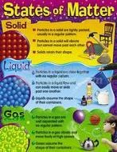
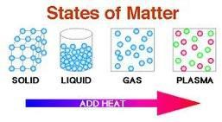
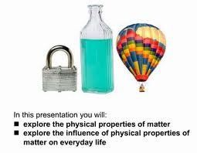
EXAMPLES OF OBSERVABLE PHYSICAL PROPERTIES
State of Matter: Matter can either be a solid, liquid, gas, or plasma.
We observe this by using our senses.

Slide 32

https://www.youtube.com/watch?v=zqzWfguYj1c

Slide 33


Slide 34
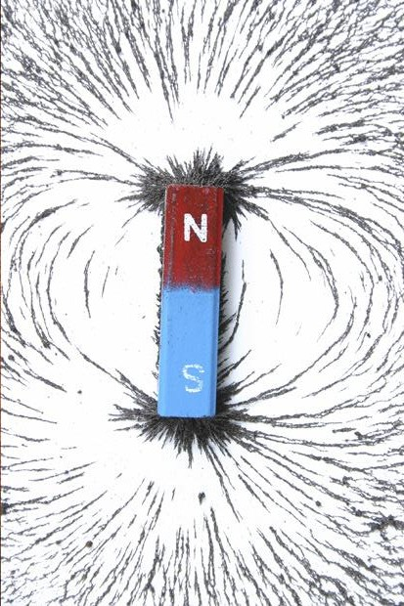

MAGNETISM
Magnetism – attraction to a magnet

Slide 35
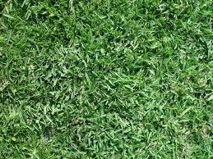



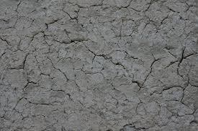
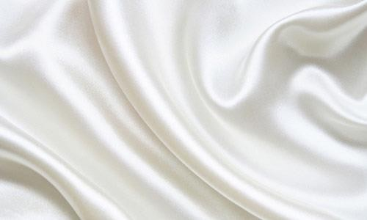

TEXTURE
Texture – the visual and tactile quality of a surface.

Slide 36
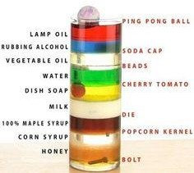


RELATIVE DENSITY
Relative Density – the density of an object
compared to its surrounding material.

Slide 37





MEASURABLE PROPERTIES OF MATTER
Measurable Properties: Properties that must be measured with a tool (ruler, beaker, graduated cylinder, scale, etc.).
Ruler
Beaker
Scale
Triple Beam Balance
Graduated Cylinder

Slide 38


MEASURABLE PROPERTIES OF MATTER
Mass - the amount of matter in an object or substance.
Calculate: Using a triple beam balance or a scale.
Unit: in science ALWAYS use grams (g) or kilograms (kg).

Slide 39



MEASURABLE PROPERTIES OF MATTER
Weight - measure of the pull of gravity on an object. Different on the MOON!!

Slide 40







MEASURABLE PROPERTIES OF MATTER
Volume - the amount of space an object takes up.
Measured by: different for regular solid, irregular solid and liquids.
Examples of Regular Solids: any solid you can measure the length, width, and height of
length x width x height
Examples of Irregular Solids: any solid you cannot measure the length, width and height of.
Examples of Liquids: any object that has no definite shape but does have a definite volume.

Slide 41








Measurable Properties of Matter
Measuring the Volume of Liquids:
How to calculate: Use a graduated cylinder to find the volume at the meniscus.
Material: graduated cylinder, beaker, flask
How to read a graduated cylinder
Must be at eye level to read.
Must read to bottom of the curve. MENISCUS - bottom of
the curve.
Unit: mL or L

Slide 42
Bottom of the MENISCUS
✔️
❌

Slide 43


MEASURABLE PROPERTIES OF MATTER
Measuring Volume of Regular Solids: measure the length, width, and height with a ruler and multiply them together.
Length x Width x Height = Volume of Regular Solid
*ALWAYS USE CENTIMETERS IN SCIENCE!!!!
UNIT: cm³

Slide 44

MEASURABLE PROPERTIES OF MATTER
Measuring Volume of Irregular Solids: Water displacement. Put water into a graduated cylinder and record volume. Place irregular solid into cylinder with water and record second volume. Subtract the two amounts.
Initial volume (water only) – volume with irregular solid = volume of solid
UNIT: measured in mL but,
since it is a solid use cm³.
1 mL = 1 cm³

Slide 45







MEASURABLE PROPERTIES OF MATTER
Density - the amount of matter in a given space or volume. Density is used to describe matter because everything has a different density.

Slide 46

These are two, unopened full cans of soda. Explain why one is floating and one has sunk.

Slide 47


Why are some objects less dense than other objects?
As the molecules of a substance spread apart, the density of the substance is lowered.
What causes molecules to spread?
Adding energy so the movement of the molecules increases.

Slide 48


Objects float in other substances because they are less dense than the substance they are floating in.

Slide 49
DENSITY
When does an objects density change?
If heat is added or taken away!!!!
HEAT – spreads out molecules – LESS dense
Take AWAY heat – molecules come together – MORE dense.
Hot objects are less dense than cool
objects!!!!

Slide 50
Calculating Density Density= Mass/Volume
A marble has a volume of 5 cm³ and a mass of 15 g. What is the density of the marble?
Given: m=15 g, V= 5 cm³
Formula: D=M/V
Solution: D=15g/ 5 cm³
U: 3g/cm³

Slide 51

Physical Properties
Boiling Point: The temperature at which a substance changes from a liquid to a gas
Water to steam
www.elmhurst.edu/~chm/vchembook/163boilingpt.html

Slide 52

Physical Properties
Melting point: The temperature at which a substance changes from a solid to a liquid
Ice cube melts to a puddle of water
http://www.uniongas.com/images/meltingIcetechnology.jpg

Slide 53

Physical Properties
Electrical conductivity: How well a substance allows electricity to flow through it
Water conducts electricity so never swim during a lightning storm
genchem.chem.wisc.edu

Slide 54






CHEMICAL PROPERTIES OF MATTER
Chemical Properties- Properties that determine whether or not a substance will react chemically.
Flammability - the ability to burn.
Reactivity - The ability for a substance to react with another. Simply, when two substances get together, something can happen.

Slide 55

Signs of a Chemical Change
Production of an odor
Eggs rotting produce a sulfur smell
Lightning produces a fresh and clean smell due to its reaction with Oxygen in the atmosphere
www.panelbuildersinc.net

Slide 56


Signs of a Chemical Change
Change in Temperature
Exothermic Reaction: Energy is released and surrounding area of reaction increases temperature (Rusting)
Endothermic Reaction: Energy is absorbed and surrounding area of reaction decreases in temperature (antacid and water)
www.webergallery.com/Rusting%20Away-CT.htm
www.superstock.com/stock-photos-images/1613R-7178

Slide 57

Signs of a Chemical Change
Change in Color
Fruit ripening (green tomatoes to red tomatoes)
Rust
www.uncp.edu/home/mcclurem/ptable/iron/fe.htm

Slide 58

Signs of a Chemical Change
Formation of Bubbles
Vinegar and baking soda
Antacid and water
eco-centric.blogspot.com

Slide 59

Signs of a Chemical Change
Formation of a Solid or Precipitate:
The shells of clams and mussels are precipitates from a chemical change of substances from the animal and sea water
unsportsmanlikecomment.files.wordpress.com

